Slide 1
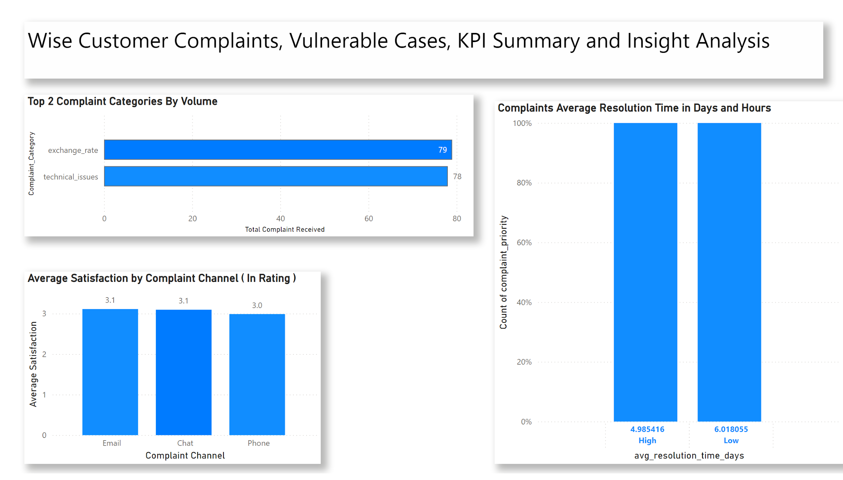
Notes:
Top 2 Complaint Categories By Volume
No alt text provided
Average Satisfaction by Complaint Channel ( In Rating )
No alt text provided
Complaints Average Resolution Time in Days and Hours
No alt text provided
textbox
No alt text provided

Slide 2
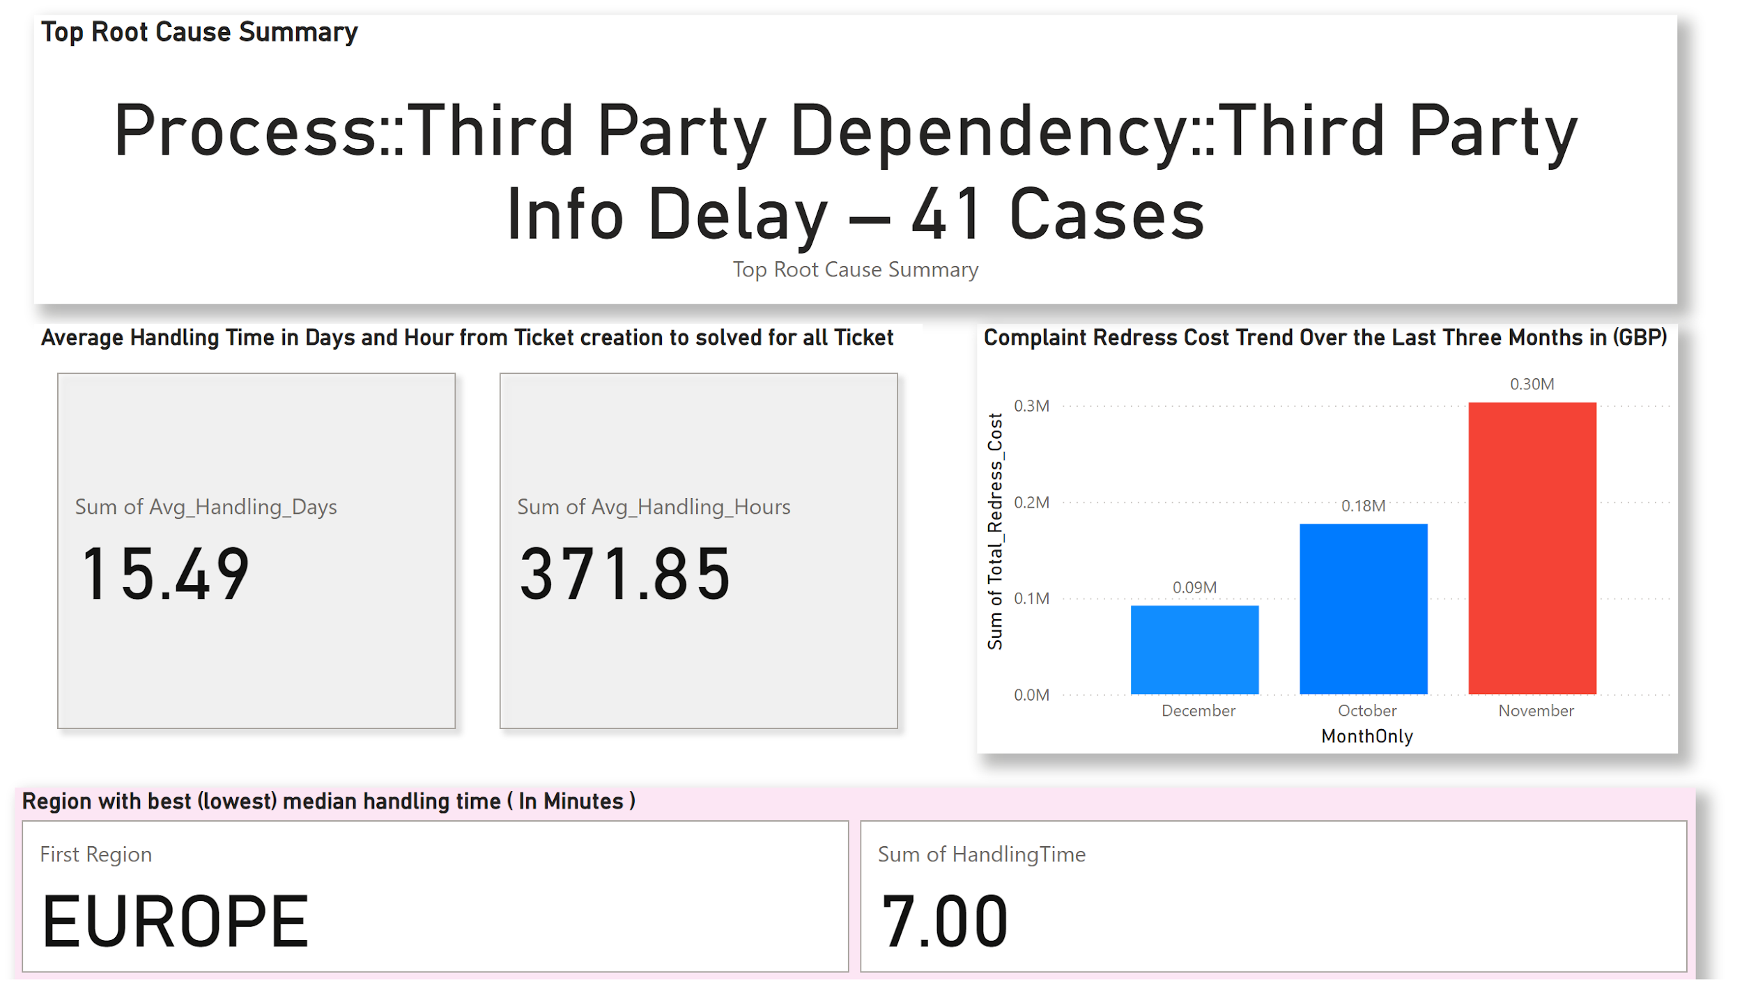
Notes:
Top Root Cause Summary
No alt text provided
Region with best (lowest) median handling time ( In Minutes )
No alt text provided
Complaint Redress Cost Trend Over the Last Three Months in (GBP)
No alt text provided
Average Handling Time in Days and Hour from Ticket creation to solved for all Ticket
No alt text provided

Slide 3
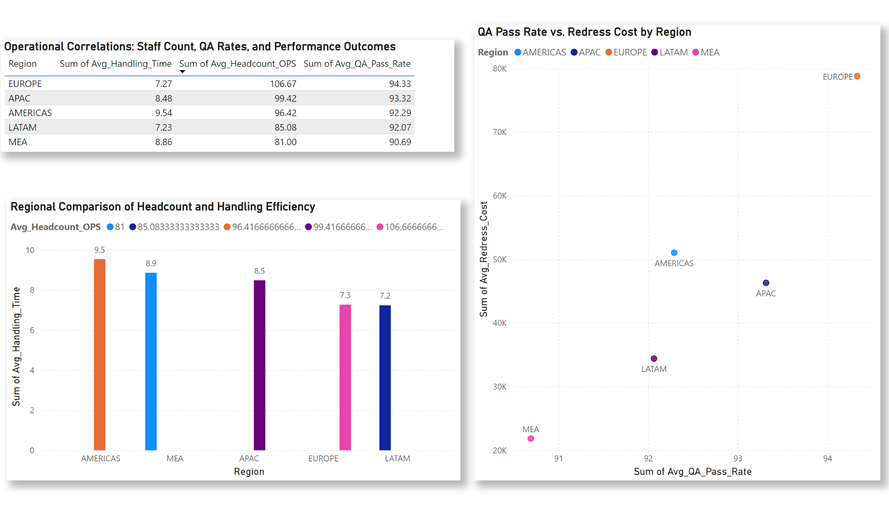
Notes:
Regional Comparison of Headcount and Handling Efficiency
No alt text provided
Operational Correlations: Staff Count, QA Rates, and Performance Outcomes
No alt text provided
QA Pass Rate vs. Redress Cost by Region
No alt text provided

Slide 4
Task 1: Complaint Category & Customer Satisfaction
Top Complaint Categories by Volume:
Exchange rate (79 complaints)
Technical Issues (78 complaints)
Average Satisfaction Rating by Channel:
Phone: ~3.0 out of 5
Chat: ~3.09 out of 5
Email: ~3.11 out of 5
Resolution Times (High vs. Low Priority):
High Priority average: 4 days, 9 hours, 8 minutes (Faster)
Low Priority average: 6 days, 0 hours, 20 minutes
Task 2: Vulnerable Customer Cases
Most Frequent Root Cause: Third Party Info Delay (41 incidents)
Average Handling Time: 15 days, 5 hours
Suggestion for Improvement: Suggest proactive updates & faster triaging
Notes:
Regional Comparison of Headcount and Handling Efficiency
No alt text provided
Operational Correlations: Staff Count, QA Rates, and Performance Outcomes
No alt text provided
QA Pass Rate vs. Redress Cost by Region
No alt text provided

Slide 5
Complaint KPIs & Trends
– • Fastest region: Europe (median handling time: 7 minutes)
– • Redress cost (Last 3 months): Oct £177k, Nov £303k, Dec £92k
– • Headcount vs handling: Higher ops staff → lower handling times
More operational staff means faster complaint resolution and happier customers. Investing in staffing directly improves service efficiency and satisfaction. This insight guides strategic resource allocation where quicker resolution is key. Optimizing staffing is a direct lever for enhanced efficiency and improved customer experience across all regions.
– • QA pass rate vs redress: Negative correlation (higher QA → lower costs)
Higher quality assurance at early stages directly leads to lower customer compensation costs. This means preventing issues upfront saves us significant money. Investing in robust QA improves efficiency and reduces financial impact.
– • Proposed KPI: First Contact Resolution Rate (impact on efficiency & satisfaction)
“First Contact Resolution Rate" measures how often we solve issues on the first call, which directly boosts efficiency and customer satisfaction. A high FCR means fewer follow-ups, lower costs, and increased customer trust. This KPI is key for ensuring our frontline resolutions are consistently effective.
Recommendations
I recommend automating complaint status updates and proactive communication, especially for common issues and vulnerable customers. This will reduce customer anxiety, boost satisfaction, lower costs, and free up our staff. Our next step is a 30-day pilot of automated notifications for exchange rate and technical issues to measure impact.
– • Automate status updates for top categories (Exchange Rate, Technical Issues)
– • Pilot real-time SMS/email notifications; assess impacts on resolution, costs, satisfaction
Notes:
Regional Comparison of Headcount and Handling Efficiency
No alt text provided
Operational Correlations: Staff Count, QA Rates, and Performance Outcomes
No alt text provided
QA Pass Rate vs. Redress Cost by Region
No alt text provided

